Slide 1
Sorting Functions

Slide 2
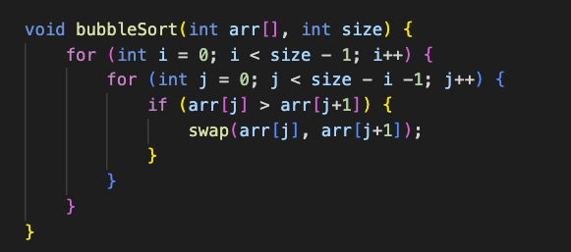
Bubble Sort
Time Complexity:
Best: O(n)
Average: O(n^2)
Worst: O(n^2)

Slide 3
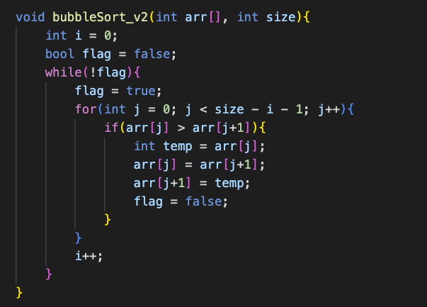
Bubble Sort v2
Time Complexity:
Best: O(n)
Average: O(n^2)
Worst: O(n^2)

Slide 4
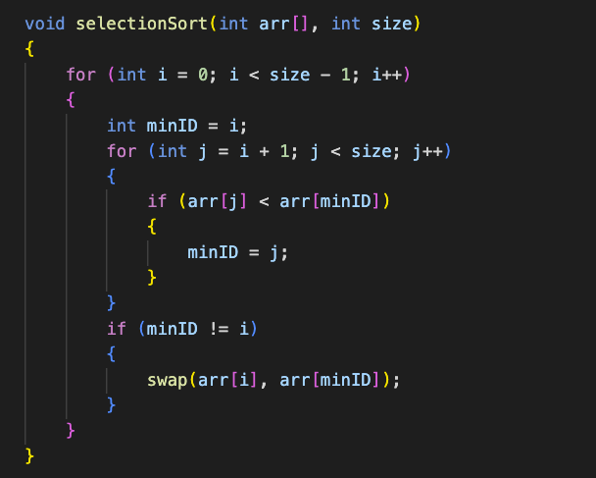
Selection Sort
Time Complexity:
Best: O(n^2)
Average: O(n^2)
Worst: O(n^2)

Slide 5
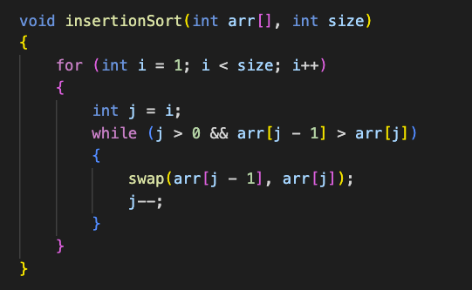
Insertion Sort
Time Complexity:
Best: O(n)
Average: O(n^2)
Worst: O(n^2)

Slide 6
Singly Linked List

Slide 7
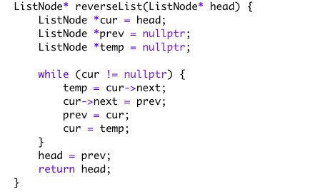
Reverse Linked List

Slide 8
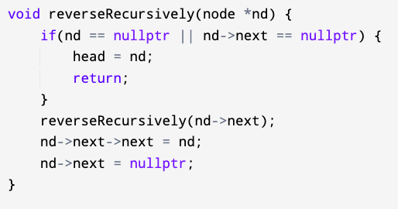
Reverse Linked List Recursively

Slide 9
Circular Linked List

Slide 10
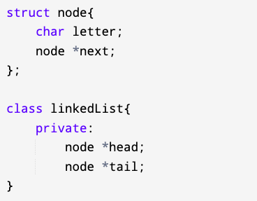
Initialize

Slide 11
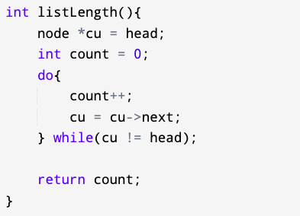
Counting Nodes

Slide 12
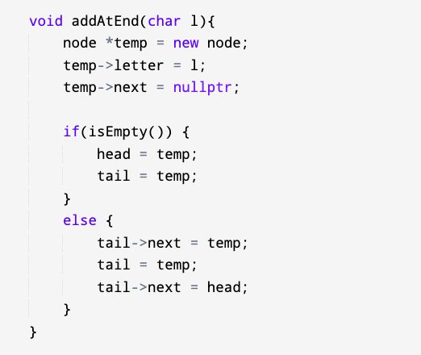
Adding Nodes at End

Slide 13
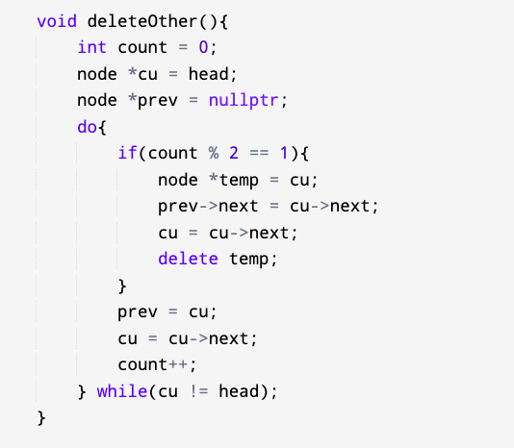
Deleting Nodes at Odd Pos

Slide 14
Credit: Eoin Donovan

